Slide 1
Data Quality and Informatics
South Carolina Department of Alcohol and Other Drug Abuse Services
Andrew Fogner, MSPH
State Epidemiologist
Sazid Khan, MPH, PhD(c)
Epidemiology Graduate Research Assistant

Slide 2
Outline
South Carolina Department of Alcohol and Other Drug Abuse Services
Data Quality and Decision Making
Data Visualization Tips
Profiles
State & County
Group Activity
Objectives: Be able to understand the importance of data quality in substance use prevention; be able to effectively use county-level data resources to communicate local needs; and, be able to create and use data vitalization tools for prevention planning processes.

Slide 3
https://www.youtube.com/watch?v=Y-lKvc8N1x8

Slide 4
What does “Data Quality” entail?

Slide 5
Key Components for Data Quality
South Carolina Department of Alcohol and Other Drug Abuse Services
Key Determinants of Data Quality
Accuracy
Accessibility
Completeness
Consistency
Reliability
Timeliness

Slide 6
Key Components Cont’d
South Carolina Department of Alcohol and Other Drug Abuse Services
Accuracy – The data must meet the high standards and rules set for its particular data field.
Accessibility – The data must be presented in a meaningful, and is easy to interpret by all.
Completeness – The more complete the data is (missing-ness is limited as much as possible), the more accurate the interpretation based on the data, will be.
Consistency – The data delivered is continuously provided at high standards.
Reliability – The data is extracted or collected from credible, validated sources
Timeliness – The data is as up to date as possible; will allow for the most current and real-time interpretation and utilization of the data.

Slide 7
Data-Informed Decision Making

Slide 8
Data-Informed Decision Making
South Carolina Department of Alcohol and Other Drug Abuse Services
Data can aid in:
Decision making
Setting and prioritizing goals
Monitoring progress
Evaluation
Data/evidence is needed in conjunction with experience to make the best decision possible
Important to find that balance between using human expertise and the available data (coupled with an understanding of what the data represents)

Slide 9
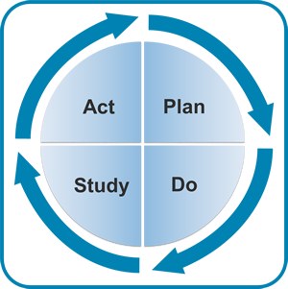
PDSA
South Carolina Department of Alcohol and Other Drug Abuse Services
Notes:
The PDSA cycle is shorthand for testing a change by developing a plan to test the change (Plan), carrying out the test (Do), observing and learning from the consequences (Study), and determining what modifications should be made to the test (Act).
i.e.
Step 1: Plan—Plan the test or observation, including a plan for collecting data
Step 2: Do—Try out the test on a small scale
Step 3: Study—Set aside time to analyze the data and study the results
Step 4: Act—Refine the change, based on what was learned from the test

Slide 10
Examples of Data Sources

Slide 11
Secondary Data Resources
South Carolina Department of Alcohol and Other Drug Abuse Services
There are many secondary sources for health-related data at the local, state and national level.
SAMHSA
CDC
SC DAODAS
SC DHEC
SC RFA
SC DHHS
SC DOC
SC DPS

Slide 12
Examples of DAODAS Data Reports

Slide 13
2017 South Carolina Epidemiological Profile on Substance Related Indicators
South Carolina Department of Alcohol and Other Drug Abuse Services
The Epidemiological profile covers a large selection of substance use and misuse data for South Carolina. The substances and subsequent consequences covered are grouped into the following categories:
Alcohol Use
Tobacco Use
Marijuana Use
Prescription Drug Overview
Substance Use Outcomes
Infectious Diseases
Intervention and Treatment Statistics
Summary Tables of changes between 2016 and 2017

Slide 14
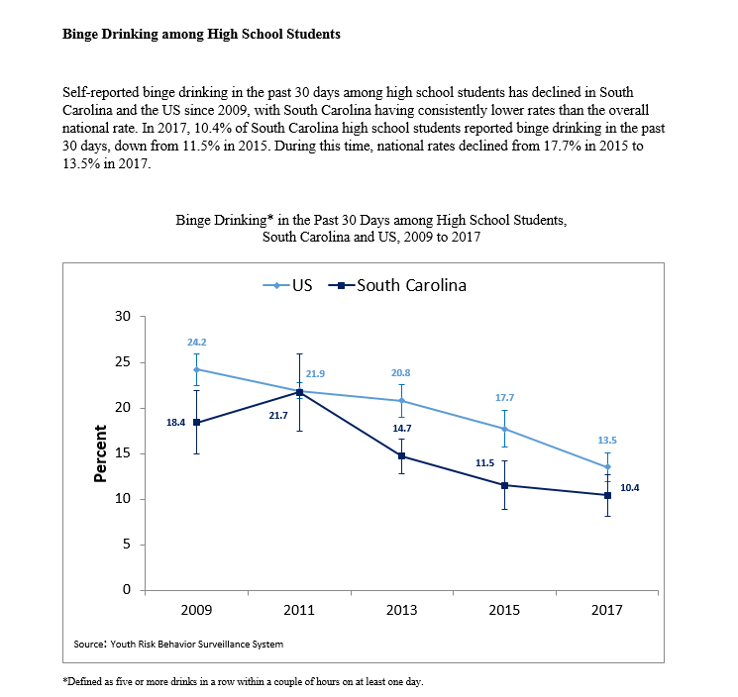
South Carolina Department of Alcohol and Other Drug Abuse Services
Notes:
Example of a page of the state epi profile

Slide 15
2018 South Carolina County-Level Profiles
South Carolina Department of Alcohol and Other Drug Abuse Services
This report is intended to shed light on the social, economic, and civic conditions in South Carolina that are associated with substance use/misuse.
Data from all 46 counties in South Carolina are included in these analyses, providing a picture of the conditions that put communities at risk for substance misuse and other related behavioral health issues.
Counties are ranked for each sub-category from 1-46 (with 1 being the best and 46 being the poorest in the state for that metric). And placed into risk quintiles (1 being the least at risk , 3 being near the state averages for that metric and 5 being the most at risk based on current statistics).

Slide 16
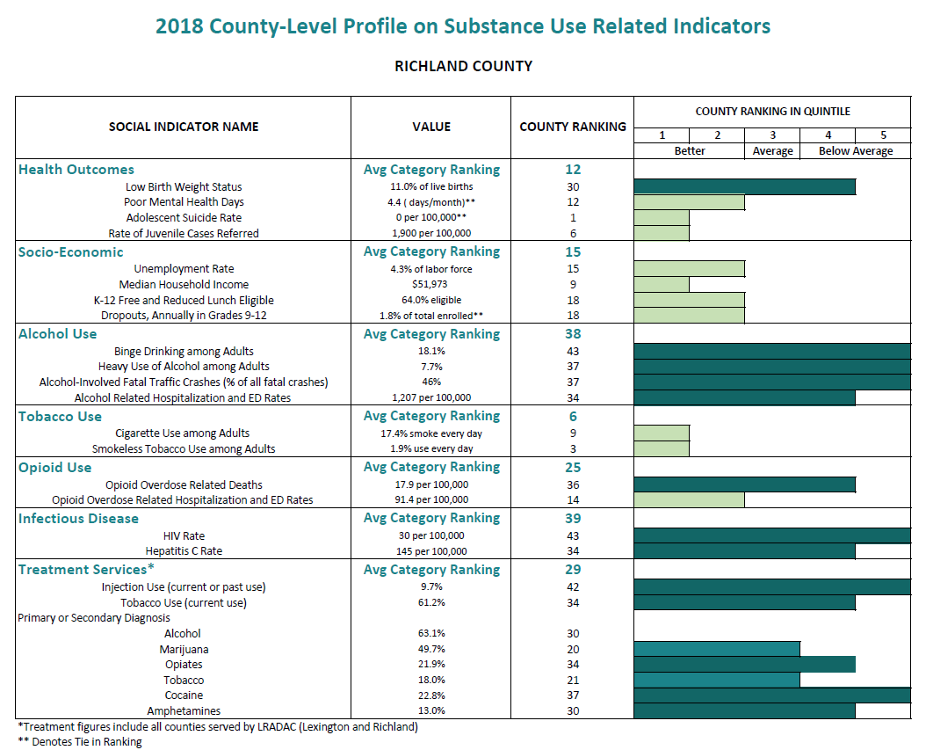
South Carolina Department of Alcohol and Other Drug Abuse Services

Slide 17
How to use the profiles
South Carolina Department of Alcohol and Other Drug Abuse Services
The county profiles can be used to:
Can help in crafting interventions in areas of need
Can evaluate current interventions/programs
Can be used by agencies that oversee multiple counties to identify areas of needs by county

Slide 18
Data Visualization Tips

Slide 19
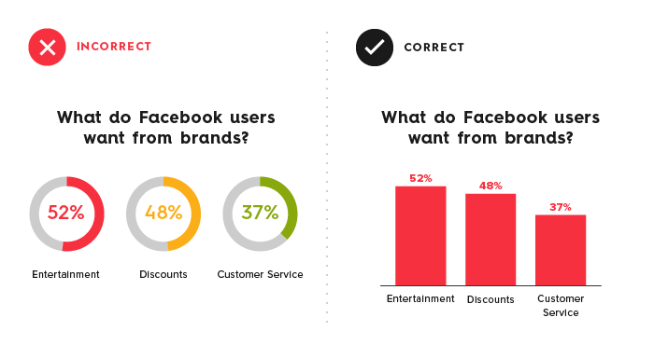
South Carolina Department of Alcohol and Other Drug Abuse Services

Slide 20
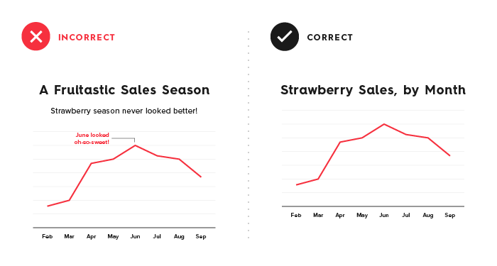
South Carolina Department of Alcohol and Other Drug Abuse Services

Slide 21
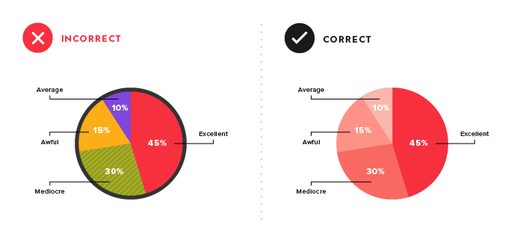
South Carolina Department of Alcohol and Other Drug Abuse Services

Slide 22
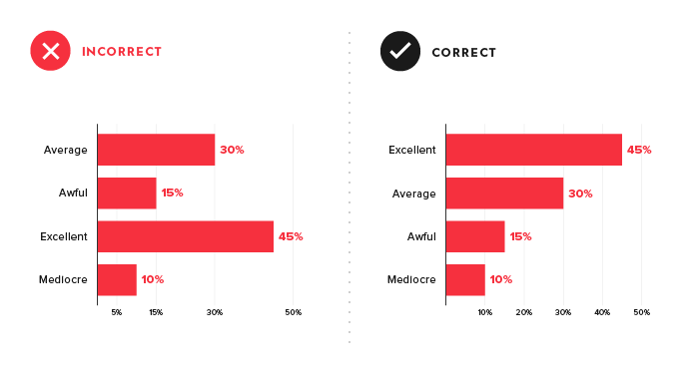
South Carolina Department of Alcohol and Other Drug Abuse Services

Slide 23
Things to Avoid
South Carolina Department of Alcohol and Other Drug Abuse Services
Misaligned mayhem
Chaotic color schemes
Illustration overkill
Typography train wreck
Data disasters

Slide 24
Tips
South Carolina Department of Alcohol and Other Drug Abuse Services
Keep it simple
Pretty doesn’t mean effective
Color
Leverage color associations
Us bright colors to highlight
5-second rule
Have a specific message

Slide 25
Excel Examples

Slide 26
Example
South Carolina Department of Alcohol and Other Drug Abuse Services

Slide 27
Example
South Carolina Department of Alcohol and Other Drug Abuse Services

Slide 28
Group Activity

Slide 29
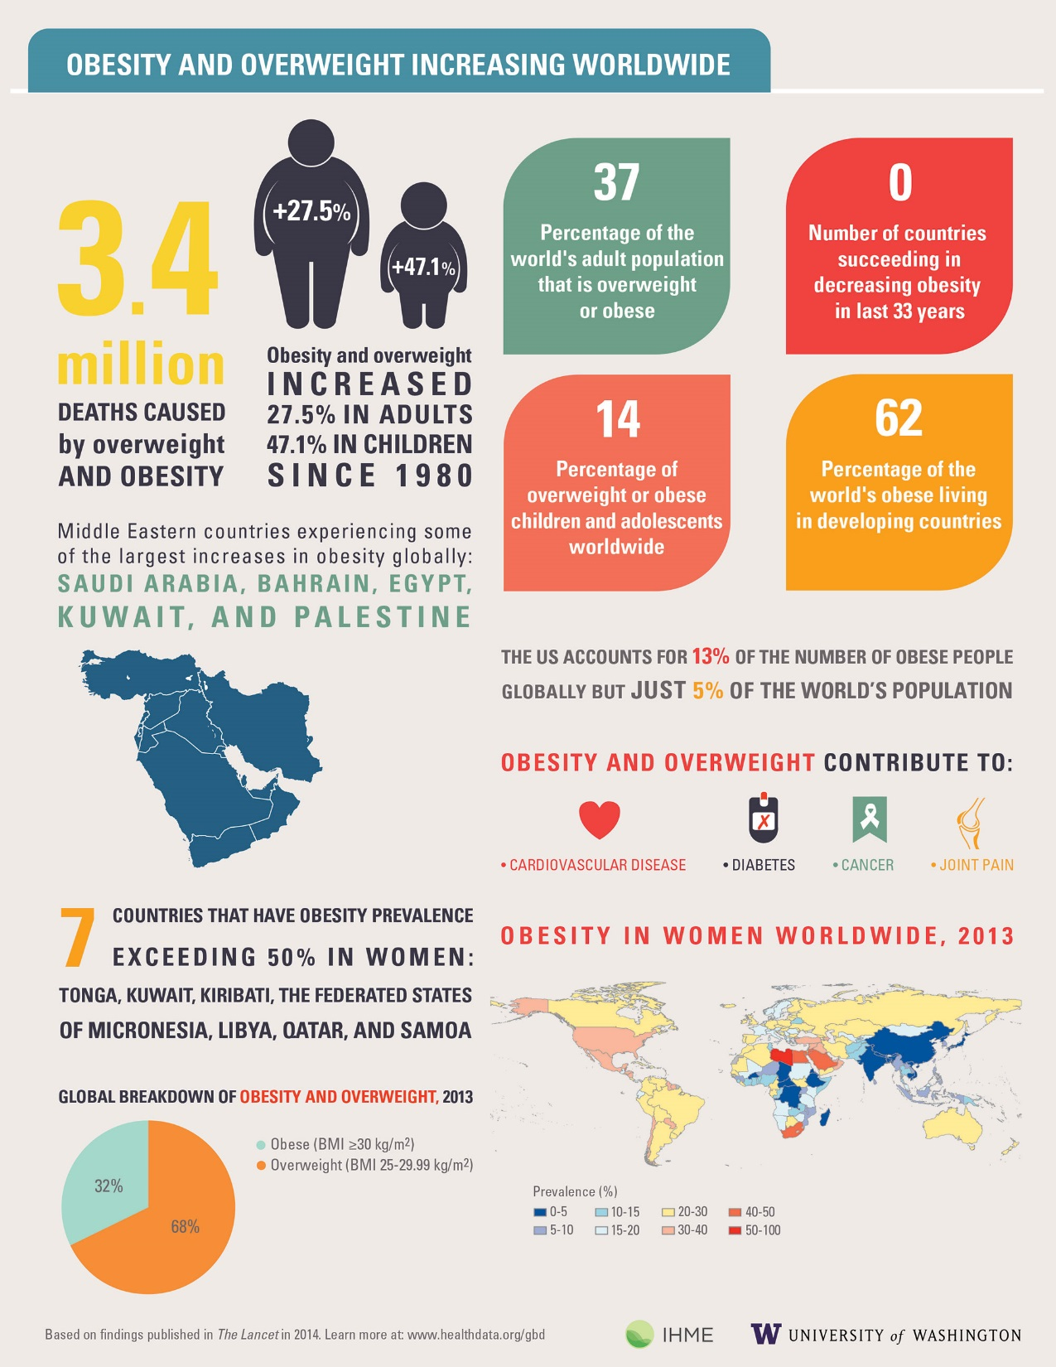
South Carolina Department of Alcohol and Other Drug Abuse Services
Notes:
Group activity of an example

Slide 30
South Carolina Department of Alcohol and Other Drug Abuse Services

