Slide 1
SFP 101: Making the Connection
An Overview of the Strengthening Families Program
Sherri Caldwell & Coretta Jamison

Slide 2
About Children’s Trust
Children’s Trust of South Carolina is the statewide organization focused on the prevention of child abuse and neglect. We provide funding, resources and training to help local program partners build strong families and positive childhoods.

Slide 3


Building a Better South Carolina
Our Mission
Strengthen families and lead communities to prevent child abuse, neglect and injuries in South Carolina.
Our Vision
South Carolina is strong — every child, every family, every community.

Slide 4

How We Prevent Child Abuse and Neglect
Capacity
Building
Thriving children
Strong families
Supportive communities
Network
Developing
System
Convening
Notes:
The 301 system and the CT system both work in similar ways to provide prevention services in our communities. Working together we can prevent substance abuse and child abuse and neglect.

Slide 5














































Are we in Your Community?
Serving 42 of 46 Counties
Home Visiting: Early intervention programs that work with young children and their families
Strengthening Families Program: Helps parents and children work better together with practical tools for reducing conflict
Triple P (Positive Parenting Program) managed through local coordinating agencies, it offers strategies and interventions for parenting to help their children’s behavior
Notes:
The four counties where we don’t have programmatic services: Calhoun, Clarendon, Cherokee and Colleton

Slide 6

Strengthening Families Program
What do you know about SFP?

Slide 7
4 W’s
1
What
What is SFP?
2
Why?
Why offer the SFP in your community?
3
Who?
Who is the target audience? Who provides SFP?
4
Where?
Where is the SFP offered?

Slide 8

What?
Notes:
This includes communications directed at general population to prevent child maltreatment, raise awareness of public, service providers and decision makers about child maltreatment​, change the prevailing attitudes and beliefs of communities, generate a demand for services and garner institutional support for desirable behaviors.

Slide 9
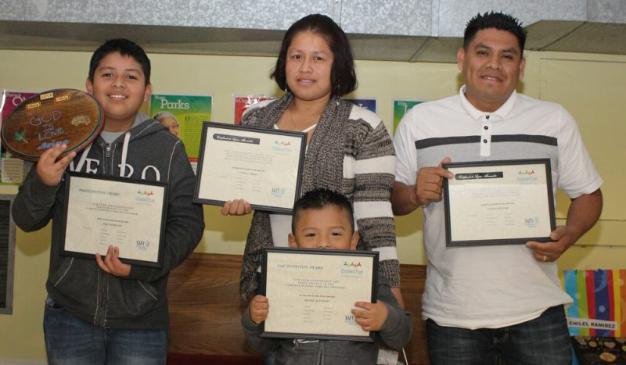
Strengthening Families Program (SFP)
The Strengthening Families Program is an Evidence Based Education program that builds communications and bonding skills between parents and their elementary school-age children
Notes:
Participants complete a 14-session weekly program. The sessions always begin with a family meal and last 2 hours. Parents and children meet separately to work with group leaders, coming together for shared activities to finish. Successful completion is celebrated with a graduation ceremony.’
SFP is made possible through a collaborative partnership with The Duke Endowment and S.C. Department of Social Services.

Slide 10
Removing Barriers and Encouraging Participation
No cost to families
Weekly attendance rewards
Transportation provided
Childcare offered at no charge
Teen activities
Sessions provided in Spanish
Participation incentives for attendance, home practice and progress

Slide 11




Typical Weekly Session
Children and caregivers meet in their groups for parallel lesson.
Family eats dinner together. Trained facilitators check in to ask how they incorporated learning from previous week.
Children and parents come back together to practice lesson.
Notes:
Parenting skills
Children’s life skills
30 minute Dinner - families sit together, with other families & Group Leaders
1st Class Hour: Parents’ and Children go to their designated Groups
2nd 30 minute Class: families rejoin & divide into Family Group(s)
Childcare: for children under 6;
(ideally, activities for children not participating in child
groups
Teens-group

Slide 12




Program Duration
2.0 Hours in person and 1.5 hours virtually
14 Sessions
Throughout the year
20 + families

Slide 13

Why?
Notes:
This includes communications directed at general population to prevent child maltreatment, raise awareness of public, service providers and decision makers about child maltreatment​, change the prevailing attitudes and beliefs of communities, generate a demand for services and garner institutional support for desirable behaviors.

Slide 14


Objectives
SFP is effective because it was specifically crafted to increase Protective Factors and reduce the Risk Factors that lead to both substance abuse and youth depression.
Increase Protective Factors
Reduce Risk Factors
Increase Family Bonding
Increase Parental Involvement
Increase Positive Communication
Decrease Family Conflict
Decrease Youth Aggression
Decrease Youth Depression
Notes:
Why: Help families develop positive discipline practices, stay resilient in touch times, reduce conflict, improve parenting skills, and assist children with social skills, relationships, and school performance.
Using documented evaluation tools, SFP skills-training proved to be effective in reducing multiple risk factors for later alcohol and drug abuse, mental health problems, and delinquency. Participants reported:
Increased family bonding
Increased parental involvement
Increased positive parenting skills
Increase positive communication
Increased family organization
Decreased family conflict
Decreased youth depression
Decreased youth aggression
Increased youth cooperation
Increased number of prosocial friends
Increased youth social competencies
Increased youth school grades

Slide 15

Who?
Notes:
This includes communications directed at general population to prevent child maltreatment, raise awareness of public, service providers and decision makers about child maltreatment​, change the prevailing attitudes and beliefs of communities, generate a demand for services and garner institutional support for desirable behaviors.

Slide 16






Two-Generation Solution
Parents/Caregivers
Children
Family
Notes:
Who: For the whole family-Parents and Children ages 6-11. 12 families participate in each cycle. Each site has 2 group leaders per skills session, 1 site coordinator, coach, child care, and other volunteers.

Slide 17
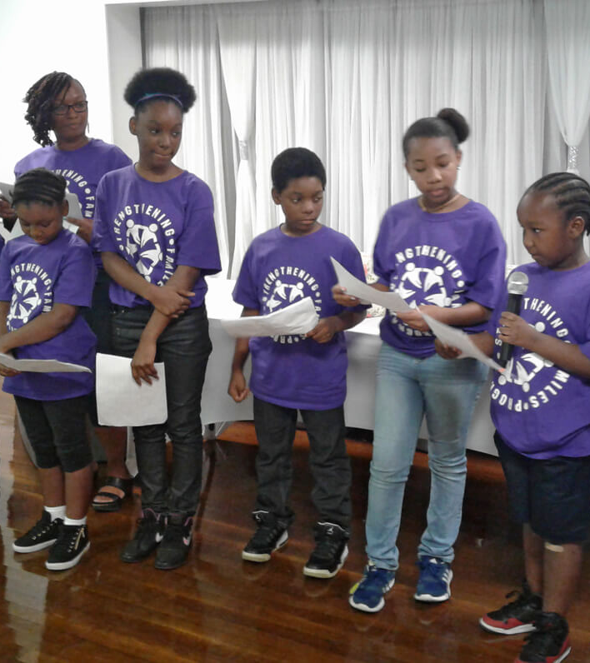
Children
Those eligible are between the ages of 6-11
Childcare available for siblings
Teens welcome to volunteer
Teen curriculum available

Slide 18

Parents
Self-referred
Referred by past participants
Referred by DSS or another organization
At-risk families
Families not considered at-risk
Notes:
Triple P or the Positive Parenting Program is a parenting and family support system designed to prevent problems in the family, school and community before they arise and to create family environments that encourage children to realize their potential. Children’s Trust supports South Carolina counties to successfully scale and sustain the Triple P system of interventions so that benefits are achieved for South Carolina parents, children and families. Currently, this system is being piloted in two counties – Greenville and Georgetown

Slide 19
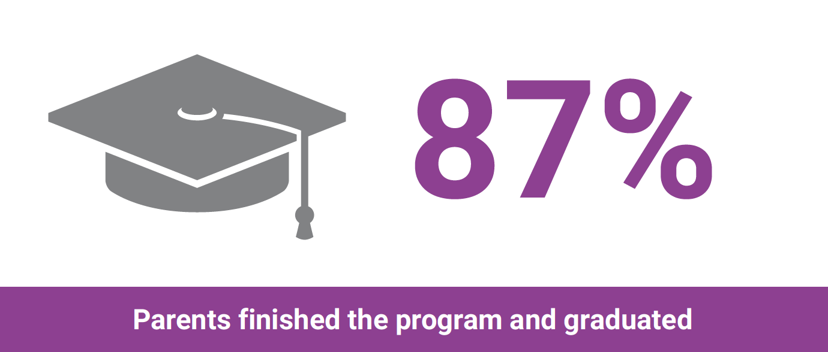
80%

Slide 20



301 System Families
Prevention Programs
Treatment Programs
Community Coalitions/Partners
Implement the Evidence-Based Program for families to prevent substance misuse/abuse or make referral to a program already being implemented
Parents in treatment have children at higher risks of developing a substance use disorder and could benefit from a family prevention program
Coalitions can apply for the Strengthening Families Grant, partner with organizations to implement, or refer families to an existing program
Notes:
We can provide

Slide 21
Where?
Notes:
This includes communications directed at general population to prevent child maltreatment, raise awareness of public, service providers and decision makers about child maltreatment​, change the prevailing attitudes and beliefs of communities, generate a demand for services and garner institutional support for desirable behaviors.

Slide 22
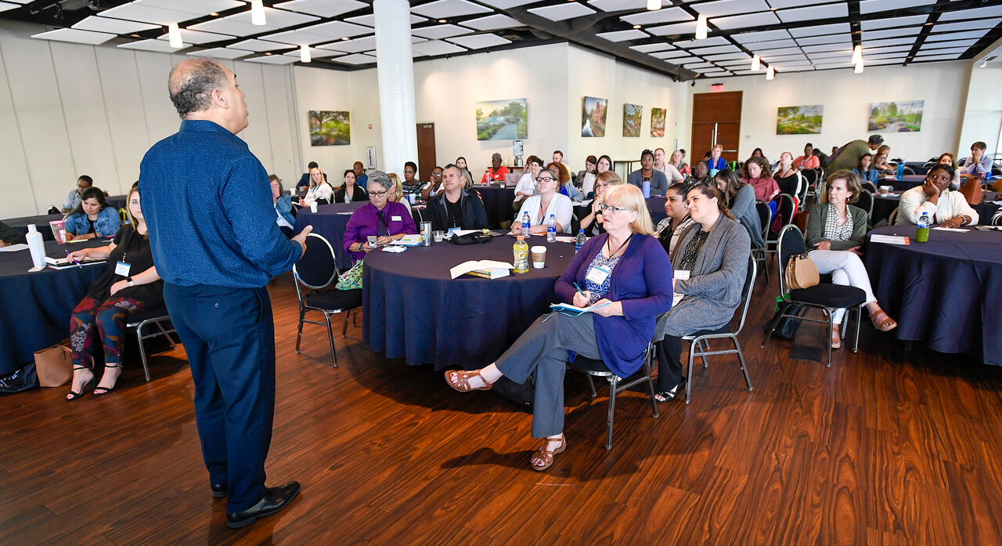
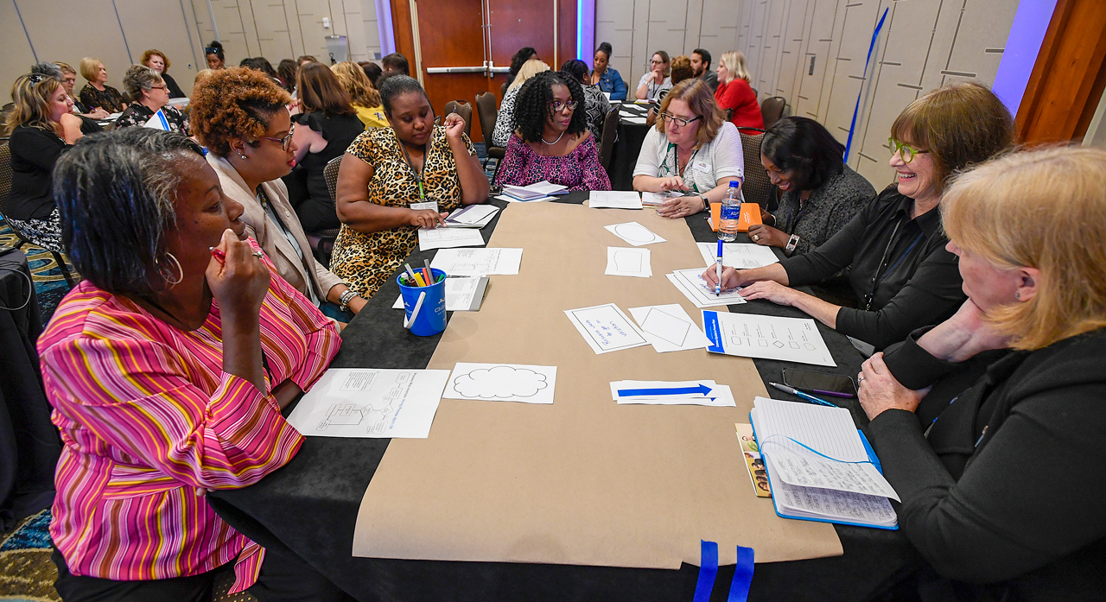
Currently Virtual
ZOOM
In-person:
  Community Centers
  Schools
  Drug Treatment Centers
  Mental health Centers
  Churches
Notes:
Where: Offered throughout the state of SC. 24 counties currently offer the program. Currently virtual- usually community centers, schools, churches, etc.
Notes: Over nearly thirty years SFP6-11 has been implemented in schools, drug treatment centers, family and youth service agencies, child protection and foster care agencies, community mental health centers, housing projects, homeless shelters, churches, and drug courts, family courts, juvenile courts, and prisons.

Slide 23














































Current Footprint: Strengthening Families Program
Cherokee
York
Pickens
Spartanburg
Oconee
Greenville
Union
Chester
Lancaster
Chesterfield
Marlboro
Anderson
Laurens
Dillon
Fairfield
Kershaw
Darlington
Newberry
Abbeville
Lee
Marion
Greenwood
Florence
Saluda
Richland
Horry
McCormick
Lexington
Sumter
Edgefield
Clarendon
Calhoun
Williamsburg
Aiken
Georgetown
Orangeburg
Barnwell
Bamberg
Berkeley
Dorchester
Allendale
Colleton
Hampton
Charleston
Jasper
Beaufort
Counties without SFP access
Counties with SFP access
24 providers
31 counties
Notes:
Counties we are not in: Cherokee, Union, Chester, Chesterfield, Marlboro, Abbeville, McCormick, Edgefield, Saluda, Allendale, Hampton, Colleton, Calhoun, Clarendon, Williamsburg, Georgetown
Here would be a great place to mention connecting with 301 system coalitions. To have the site coordinators join the substance abuse and/or community coalitions.

Slide 24
Referral Link https://childrensstrustofsc.wufoo.com/forms/sklz0kb16ug996/
Notes:
This includes communications directed at general population to prevent child maltreatment, raise awareness of public, service providers and decision makers about child maltreatment​, change the prevailing attitudes and beliefs of communities, generate a demand for services and garner institutional support for desirable behaviors.

Slide 25

Questions and Answers

Slide 26
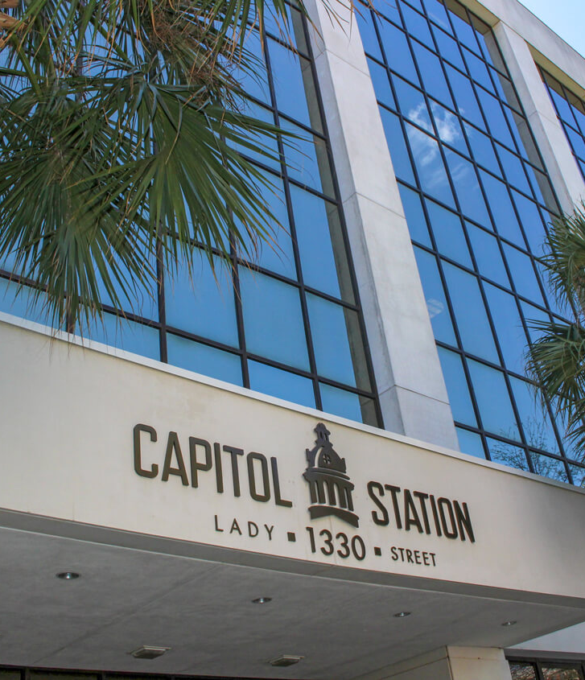
Contact Us
Children’s Trust of South Carolina
1330 Lady Street, Suite 310
Columbia, SC 29201
Phone 803-733-5430
Email info@scchildren.org
ChildrensTrustSC
ChildrensTrustS
scChildren.org

