Slide 1
The State of Prevention Needs, Gaps, and Resources
Michelle Nienhius, MPH, DAODAS
Crystal Gordon, MSW, LMSW, DAODAS
Cecily Watkins, MPH, DAODAS
Katie Godowns, MA, CSPS, BCADAD
Galen Sturup Comeau, BA, BCADAD
Notes:
Custom DAODAS color codes is : Red-0
Green-131
Blue-139

Slide 2
The State of
2020
Needs
Gaps
&
Resources
Notes:
Content Slide With No Bottom Border

Slide 3
Session Content
Overview of Block Grant Data Trends
Engaging Other Audiences
Media Beyond Social Media
Self-Care
Notes:
Section Header Slide

Slide 4
Session Handouts
Prevention Strategies
Potential Funding Sources
Technology to Support Remote Work
Training Opportunities
Social Media
Burnout
Self-Care
Handouts will be posted on the
SC Documents Webpage.
Notes:
Section Header Slide

Slide 5
The State of Prevention Needs, Gaps, and Resources
Overview of
Block Grant Data Trends
Notes:
Section Header Slide

Slide 6
Overview of Block Grant Data Trends
Goal: To reduce underage alcohol use in South Carolina.
Objectives:
Decrease past month alcohol use (30-day use) among South Carolina high school students to 25% or less (measured by the YRBS-odd years)
Decrease past month alcohol use (30-day use) among South Carolina high school students to 16% or less (measured by the SC Communities that Care (CTC) Survey-even years)
Decrease retail access to alcohol (underage alcohol buy rate) for the state of South Carolina to 10% or less (measured by AET statewide data)
FY 21-22 Application
Notes:
Content Slide

Slide 7
Overview of Block Grant Data Trends
Decrease past month alcohol use (30-day use) among South Carolina high school students to 25% or less (measured by the Youth Risk Behavior Survey-odd years)
Year | 2005 | 2007 | 2009 | 2011 | 2013 | 2015 | 2017 | 2019
United States | 43.3% | 44.7% | 41.8% | 38.7% | 34.9% | 32.8% | 29.8% | 29.2%
South Carolina | 43.2% | 36.8% | 35.2% | 39.7% | 28.9% | 24.6% | 25.4% | 23.1%
FY 21-22 Application
Notes:
Content Slide

Slide 8
Overview of Block Grant Data Trends
Decrease past month alcohol use (30-day use) among South Carolina high school students to 16% or less (measured by the SC Communities that Care (CTC) Survey-even years)
Year | 2010 | 2012 | 2014 | 2016 | 2018 | 2020
Statewide | 35.3% | 37.9% | 30.1% | 20.4% | 16.0% | 10.4%
FY 21-22 Application
Notes:
Content Slide

Slide 9
Overview of Block Grant Data Trends
Decrease retail access to alcohol (underage alcohol buy rate) for the state of South Carolina to 10% or less (measured by AET statewide compliance check data)
Year | 2007 | 2008 | 2009 | 2010 | 2011 | 2012 | 2013 | 2014 | 2015 | 2016 | 2017 | 2018 | 2019
State Buy Rate | 20.3% | 19.4% | 18.2% | 14.3% | 12.3% | 14.4% | 12.0% | 11.4% | 11.7% | 11.1% | 8.6% | 6.9% | 7.6%
FY 21-22 Application
Notes:
Content Slide

Slide 10
Overview of Block Grant Data Trends

Slide 11
Overview of Block Grant Data Trends
Goal: To reduce alcohol-related car crashes across South Carolina.
Objective:
Decrease the percentage of motor vehicle fatalities in which one or more drivers had a BAC of 0.08 or higher to 40% or less.
FY 21-22 Application

Slide 12
Overview of Block Grant Data Trends
Decrease the percentage of motor vehicle fatalities in which one or more drivers had a BAC of 0.08 or higher to 40% or less. (Fatality Analysis Reporting System-FARS)
Year | 2007 | 2008 | 2009 | 2010 | 2011 | 2012 | 2013 | 2014 | 2015 | 2016 | 2017 | 2018
United States | 32% | 31% | 32% | 31% | 30% | 31% | 31% | 30% | 29% | 29% | 29% | 28%
South Carolina | 43% | 43% | 42% | 44% | 37% | 40% | 44% | 40% | 31% | 33% | 31% | 28%
FY 21-22 Application

Slide 13
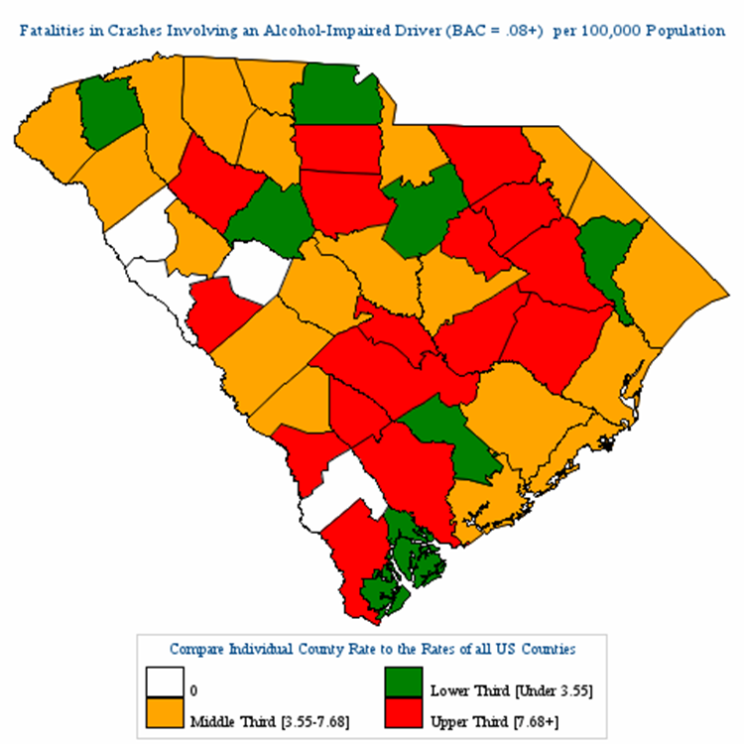
Overview of Block Grant Data Trends

Slide 14
Overview of Block Grant Data Trends
High School youth who reported “Rode with a driver who had been drinking alcohol.” Youth Risk Behavior Survey
Year | 2005 | 2007 | 2009 | 2011 | 2013 | 2015 | 2017 | 2019
United States | 28.5% | 29.1% | 28.3% | 24.1% | 21.9% | 20.0% | 16.5% | 16.7%
South Carolina | 30% | 26.3% | 27.4% | 26.3% | 21.3% | 18.0% | 18.1% | 16.6%

Slide 15
Overview of Block Grant Data Trends
High School youth who reported “Drove when they had been drinking alcohol.” Youth Risk Behavior Survey
Year | 2013 | 2015 | 2017 | 2019
United States | 10.0% | 7.8% | 5.5% | 5.4%
South Carolina | 8.4% | 3.5% | 7.5% | 4.0%

Slide 16
Overview of Block Grant Data Trends
Goal: To reduce tobacco/nicotine use among youth in South Carolina.
Objectives:
To reduce the state Retailer Violation Rate (RVR) to 8% or less.
Decrease past-month (30-day use) tobacco use among South Carolina high school students to 20% or less as measured by the YRBS.
Decrease the retail access of tobacco products to youth to 5% or less in South Carolina.
Decrease past month tobacco use-cigarette (30-day use) among South Carolina high school students to 5% or less as measured by the SC Communities That Care (CTC) Survey.
Decrease past month tobacco use-smokeless (30-day use) among South Carolina high school students to 5% or less as measured by the SC Communities That Care (CTC) Survey.
Decrease past month tobacco use-vaping (30-day use) among South Carolina high school students to 10% or less as measured by the SC Communities That Care (CTC) Survey.
FY 21-22 Application

Slide 17
Overview of Block Grant Data Trends
To reduce the state Retailer Violation Rate (RVR) to 8% or less.
FY 21-22 Application

Slide 18
Overview of Block Grant Data Trends
Decrease past month cigarettes, cigars, smokeless tobacco or electronic vapor product use (30-day use) among South Carolina high school students to 20% or less (measured by the Youth Risk Behavior Survey-odd years)
Year | 2017 | 2019
United States | 19.5% | 36.5%
South Carolina | 21.6% | 27.5%
FY 21-22 Application
Notes:
Content Slide

Slide 19
Overview of Block Grant Data Trends
Decrease retail access to alcohol (underage alcohol buy rate) for the state of South Carolina to 10% or less (measured by AET statewide compliance check data)
Year | 2007 | 2008 | 2009 | 2010 | 2011 | 2012 | 2013 | 2014 | 2015 | 2016 | 2017 | 2018 | 2019
State Buy Rate | 20.3% | 19.4% | 18.2% | 14.3% | 12.3% | 14.4% | 12.0% | 11.4% | 11.7% | 11.1% | 8.6% | 6.9% | 7.6%
FY 21-22 Application
Notes:
Content Slide

Slide 20
Overview of Block Grant Data Trends
Decrease past month cigarette use (30-day use) among South Carolina high school students to 5% or less (measured by the SC Communities that Care (CTC) Survey-even years)
Year | 2010 | 2012 | 2014 | 2016 | 2018 | 2020
Statewide | 18.7% | 19.9% | 15.3% | 6.2% | 5.2% | 2.4%
FY 21-22 Application

Slide 21
Overview of Block Grant Data Trends
Decrease past month tobacco use-smokeless (30-day use) among South Carolina high school students to 5% or less as measured by the SC Communities That Care (CTC) Survey.
Year | 2010 | 2012 | 2014 | 2016 | 2018 | 2020
Statewide | 12.9% | 11.2% | 11.5% | 5.7% | 5.7% | 3.2%
FY 21-22 Application

Slide 22
Overview of Block Grant Data Trends
Decrease past month tobacco use-smokeless (30-day use) among South Carolina high school students to 5% or less as measured by the SC Communities That Care (CTC) Survey.
Year | 2010 | 2012 | 2014 | 2016 | 2018 | 2020
Statewide | 12.9% | 11.2% | 11.5% | 5.7% | 5.7% | 3.2%
FY 21-22 Application

Slide 23
Overview of Block Grant Data Trends
Decrease past month tobacco use-vapes (30-day use) among South Carolina high school students to 10% or less as measured by the SC Communities That Care (CTC) Survey.
Year | 2010 | 2012 | 2014 | 2016 | 2018 | 2020
Statewide | N/A | N/A | N/A | 13.8% | 14.9% | 10.8%
FY 21-22 Application

Slide 24
Overview of Block Grant Data Trends

Slide 25
Overview of Block Grant Data Trends
Goal:
To provide primary prevention programs and practices to prevent substance abuse and improve the well-being of youth and families in South Carolina.
Objectives:
95% or more of individuals participating in primary prevention educational programs will be served using evidence-based universal, selected and indicated programs.
To reduce the percentage of South Carolina high school students reporting the use of marijuana in the past 30 days.
To reduce the percentage of South Carolina high school students reporting they ever took a prescription pain medicine without a doctor's prescription or differently than how the doctor told them to use it.
FY 21-22 Application

Slide 26
Overview of Block Grant Data Trends
To reduce the percentage of South Carolina high school students reporting the use of marijuana in the past 30 days to 17% or less as measured by the Youth Risk Behavior Survey-odd years
Year | 2005 | 2007 | 2009 | 2011 | 2013 | 2015 | 2017 | 2019
United States | 20.2% | 19.7% | 20.8% | 23.1% | 23.4% | 21.7% | 19.8% | 21.7%
South Carolina | 19.0% | 18.6% | 20.4% | 24.1% | 19.6% | 17.8% | 18.6% | 17.9%
FY 21-22 Application

Slide 27
Overview of Block Grant Data Trends
To reduce the percentage of South Carolina high school students reporting they ever took a prescription pain medicine without a doctor's prescription or differently than how the doctor told them to use it to 15% or less as measured by the Youth Risk Behavior Survey-odd years
Year | 2017 | 2019
United States | 15.2% | 15.6%
South Carolina | 14.0% | 14.3%
FY 21-22 Application

Slide 28
Overview of Block Grant Data Trends
Data Sources for National and State Data:
https://www.cdc.gov/healthyyouth/data/yrbs/index.htm
https://nsduhweb.rti.org/respweb/homepage.cfm
https://www.nhtsa.gov/research-data/fatality-analysis-reporting-system-fars
http://ncweb.pire.org/
http://justplainkillers.com/data/
FY 21-22 Application

Slide 29
The State of Prevention Needs, Gaps, and Resources
Engaging
Other Audiences
Notes:
Section Header Slide

Slide 30
Engaging Other Audiences
Statement of the Obvious
COVID-19 has changed how we engage partners in significant ways. We change, adapt, and grow but that is not always easy.
We are determined to engage and serve communities.
We persist.
#SCPreventionStrong
Notes:
Content Slide

Slide 31
Engaging Other Audiences
As access to traditional service locations shift, please continue to extend service opportunities to new and non-traditional populations and service locations, such as:
Elementary school age youth
Continue to brainstorm access to middle and high school students
Private schools
Faith organizations
Boys & Girls Clubs
All day child care centers
Adult Detention Centers
Juvenile Detention Centers
Domestic Violence Shelters
Homeless Shelters
Retailers (i.e. pharmacies, grocery stores, restaurants)
Local utilities providers
Local DHEC Office
Civic and fraternal organizations
Healthcare facilities (i.e. provide coloring books or activity kits for children and vulnerable adults)
Notes:
Content Slide

Slide 32
The State of Prevention Needs, Gaps, and Resources
Media Beyond
Social Media
Notes:
Section Header Slide

Slide 33
Media Beyond Social Media
Websites: Your Agency’s & Partner’s Websites
Your agency
Local government
Radio station
Newspaper
Youth serving organizations
Schools and School District
Faith-based organizations
Businesses
Law enforcement
Coroner
Hospital
Physician’s Offices
Other health facilities
Gyms
Civic groups
Fraternal Organizations
Local DHEC Office
Local universities
Local pharmacies
Local magazines
Local Clemson Extension
Local foundations
Local library
Local coalitions
Notes:
Content Slide

Slide 34
Media Beyond Social Media
Print, Audio, & Digital Media
Media Type *Also available by others | Ways to Disseminate Media Without Social Media
 | Billboard | Email | Radio | Newspaper | Website | Conference Call | Webinar | Business/ Government/ Organizations
PSA*
Flyers, Fact/Tip Sheet*
Poster*
Media Campaign*
Speaking Engagement
Letter to Editor
Marketing Material*
Newsletter
Videos & Podcast*
Notes:
Content Slide

Slide 35
Media Beyond Social Media
Example: Beaufort County Alcohol & Drug Abuse Department
Creates and distributes a monthly newsletter in addition to its social media efforts.
BCADAD Prevention Team
Wade E. Bishop, CSPS, Director of Prevention
Katie Godowns, MA, CSPS, Prevention Specialist
Galen Sturup Comeau, BA, Prevention Specialist

Slide 36
Media Beyond Social Media
Social Media: Ask Partners for Collaborative Shares
Your agency
Local government
Radio station
Newspaper
Youth serving organizations
Schools and School District
Faith-based organizations
Businesses
Law enforcement
Coroner
Hospital
Physician’s Offices
Other health facilities
Gyms
Civic groups
Fraternal Organizations
Local DHEC Office
Local universities
Local pharmacies
Local magazines
Local Clemson Extension
Local foundations
Local library
Local coalitions
Notes:
Content Slide

Slide 37
The State of Prevention Needs, Gaps, and Resources
Self-Care
Notes:
Section Header Slide

Slide 38
Self-Care
Breathe Deeply, Slowly.
Everyday.
Notes:
Content Slide

Slide 39
Self-Care
Daily Self-Care
Take time on what helps you feel at your best – and make those things habits.
Move – Stretch – Go for a walk – Go outside and get some sun
Stay Hydrated – Drink lots of water
Connect – Video Chat with friends and family – Send letters or cards to others
Breathe – Practice deep breathing – Do a mindful breathing exercise when overwhelmed (mindful.org)
Be Purposeful – Focus on what matters most – Set a daily intention
Notes:
Content Slide

Slide 40
Self-Care
Notes:
Content Slide

Slide 41
Self-Care
Grounding Yourself Write the following:
5 Things I can See Right now
4 Things I can Feel Right Now
3 Things I can Hear Right Now
2 Things I can Smell Right now
1 Good Thing about Yourself
Notes:
Content Slide

Slide 42
Self-Care
Consider Making a Self-Care List
What is a Self-Care List?
A list of activities that can help you cope with stress on a regular basis and enhance your well-being.
Source: https://www.youtube.com/watch?v=3r2c2ExZoUM
Why Use a Self-Care List?
To cope with or avoid feeling:
Down/in a funk
Exhausted
Frustrated, or…
When you need a time out!
Notes:
Content Slide

Slide 43
Self-Care
You are worth it. Be kind to yourself!
-Take five.
-Take scheduled breaks.
-Take time to turn it “off”.
-Take it easy on yourself.
-Take time to be your whole self.
-Take down-time and fun seriously!
Notes:
Content Slide

Slide 44
Questions?
Notes:
Q&A Slide

Slide 45
1801 Main Street, 4th Floor • Columbia, South Carolina 29201
telephone: 803-896-5555 • fax: 803-896-5558
www.daodas.sc.gov
Notes:
Final Slide

