Slide 1
New Prevention Employee Orientation
Division of Prevention and Intervention Services

Slide 2
What is Substance Misuse Prevention?
Substance misuse prevention is a complex process requiring more than a single strategy or approach. A wide range of factors contributes to alcohol and other drug problems, and their prevention is based on the understanding that these factors vary among individuals, geographic regions, age groups, racial/ethnic groups, and gender groups. Effective prevention is a systemic responsibility involving local, state, and national agencies, organizations, and groups.
Click on the link below to view a short video from SAMHSA:
This is Prevention. This is Changing Lives. (NPW 2019)
Notes:
Content Slide

Slide 3
What is Addiction?
Prevention professionals need to understand how substance use disorders (SUDs) occur. Provided below is a condensed definition of “addiction.” To learn more about addiction, please review the resources listed in this presentation.
The National Institute on Drug Addiction defines addiction as “a chronic, relapsing disorder characterized by compulsive drug seeking and use despite adverse consequences. It is considered a brain disorder, because it involves functional changes to brain circuits involved in reward, stress, and self-control, and those changes may last a long time after a person has stopped taking drugs. Addiction is a lot like other diseases, such as heart disease. Both disrupt the normal, healthy functioning of an organ in the body, both have serious harmful effects, and both are, in many cases, preventable and treatable. If left untreated, they can last a lifetime and may lead to death.”
Please click on the link below to view a short video from the Center on Addiction:
That's Right. Addiction is a Disease.
Notes:
Content Slide

Slide 4
Public Health
In 2016, the Surgeon General released Facing Addiction in America: The Surgeon General's 2016 Report on Alcohol, Drugs, and Health, calling for a comprehensive public health-based approach to addressing substance use disorders.
Public health is the science of preventing disease and injury and promoting and protecting the health of populations and communities. Public health recognizes the multi-faceted nature of substance misuse and focuses on addressing the myriad of individual, environmental, and social factors that contribute to substance use disorders.
A public health approach involves allied health professionals, families, schools, social services, neighborhoods, and communities to create conditions that will foster well-being.
Notes:
Content Slide

Slide 5
S.C. Department of Alcohol and Other Drug Abuse Services (DAODAS) and the County Alcohol and Drug Abuse Authorities
Notes:
Section Header Slide

Slide 6
DAODAS
DAODAS is the South Carolina government agency charged with ensuring quality services to prevent or reduce the negative consequences of substance use and addictions.
The mission of DAODAS is to ensure the availability and quality of a continuum of substance use services, thereby improving the health status, safety, and quality of life of individuals, families, and communities across South Carolina.
DAODAS coordinates a statewide system of county alcohol and drug abuse authorities that provide prevention, treatment, and recovery services.
To access DAODAS’s website, follow this link: http://www.daodas.sc.gov
Notes:
Content Slide

Slide 7
DAODAS
DAODAS is the single state authority for alcohol and other drug use programming as originally authorized by Public Law 91-616 of 1970 and Public Law 92-255 of 1972.
The department reports directly to the Governor and is responsible for advising the executive branch of state government, the General Assembly, and other state agencies regarding alcohol and other drug use issues.
Recognizing the need for direct services for the general public, as well as for specific high-risk groups, DAODAS offers a wide array of prevention, intervention, and treatment services through a community-based system of care.
Notes:
Content Slide

Slide 8
DAODAS
Although services are coordinated at the state level through DAODAS, the department in turn subcontracts with 32 county alcohol and drug abuse authorities to provide direct services to citizens in all 46 counties of the state.
To ensure the quality of these services, each of the state's county authorities is accredited by CARF, a nationally recognized authority on and promoter of quality services for people with disabilities.
Notes:
Content Slide

Slide 9
County Alcohol and Drug Abuse Authorities
DAODAS contracts with each county authority to provide comprehensive prevention, intervention, and treatment services targeting alcohol, tobacco and other drug misuse, and these services are available in each county. To view a list of these agencies by county, follow this link: https://www.daodas.sc.gov/treatment/local-providers/.
Each year, more than 50,000 individuals receive prevention, intervention, and/or treatment services from the county authorities. Since their creation in 1973, these agencies have provided services to more than 1 million South Carolinians.
The county authorities are members of Behavioral Health Services Association of South Carolina Inc. (BHSA). To learn more about BHSA, follow this link: http://www.behavioralhealthofsc.org/
Notes:
Content Slide

Slide 10
Overview of the Substance Abuse Prevention and Treatment Block Grant (SABG)
The Key Source of Funding Provided to the County Authorities by DAODAS
Notes:
Section Header Slide

Slide 11
SABG Overview
The SABG is administered by the Substance Abuse and Mental Health Services Administration (SAMHSA), within the Department of Health and Human Services.
The SABG is the largest federal formula grant to state alcohol and drug authorities, supporting substance use disorder prevention, treatment, and recovery efforts.
Federal statute requires states to direct at least 20% of the SABG toward primary prevention services. The “prevention set-aside,” which is managed by SAMHSA’s Center for Substance Abuse Prevention (CSAP), represents the single largest source of funding in each state’s prevention system.
The SABG enables states and jurisdictions to provide substance misuse prevention activities and treatment/recovery support services, and it places an emphasis on the provision of treatment services to populations of focus, specifically persons who inject drugs, pregnant women, and women with dependent children. The program also aims to make primary prevention services available to individuals not in need of substance use treatment.
Notes:
Content Slide

Slide 12
SABG Overview
SAMHSA mandates that each SABG grantee must:
Have a designated unit of its executive branch that is responsible for administering SABG work
Apply annually for SABG funds
Have the flexibility to distribute SABG funds to local government entities (municipalities, counties, intermediaries), including administrative service organizations
Have SABG sub-recipients, such as community- and faith-based organizations (non-governmental organizations) and deliver:
Prevention activities to individuals and communities impacted by substance use
Treatment and recovery support services to individuals and families impacted by SUDs
In South Carolina, DAODAS administers SABG funds to the county authorities for implementation of prevention, treatment, and recovery services.
Notes:
Content Slide

Slide 13
DAODAS Annual Funding & Compliance Contracts With County Authorities
The annual contracts:
Convey to the sub-grantees all of the federal SABG terms, conditions, assurances, funding agreements, and certifications.
Provide all key partners with information necessary to maintain compliance with federal statutes associated with the federal SABG.
Outline relevant changes to federal requirements, while also highlighting identified state requirements.
Notes:
Content Slide

Slide 14
Prevention-Related Requirements in the Annual Funding & Compliance Contract
Notes:
Section Header Slide

Slide 15
Overview of Prevention Requirements
Given that the Funding & Compliance Contracts are issued on an annual basis, the best way to determine current requirements is to view the contract for the current fiscal year. To view the current Funding & Compliance Contract, follow this link: http://ncweb.pire.org/scdocuments/
In general, requirements include (but may not be limited to):
Prevention staffing
Prevention certification
Primary prevention strategies
Outcomes-focused primary prevention activities
CSAP strategies
Priority areas
Priorities and goals
Synar
Alcohol Enforcement Teams
Prevention database reporting
Evaluation
Notes:
Content Slide

Slide 16
Prevention Services and CSAP Strategies Required by the SABG
Primary Prevention
By statute, the SABG prevention set-aside must be spent on primary prevention services or services for individuals who have not been identified as needing treatment.
Primary Prevention Strategies
Grantees must develop a comprehensive primary prevention program that includes activities and services provided in a variety of settings. The program must target both the general population and sub-groups that are at high risk for substance misuse. The program must include, but is not limited to, the following strategies defined by the Center of Substance Abuse Prevention (CSAP strategies):
Information Dissemination
Education
Environmental
Community-Based Process
Problem Identification & Referral
Alternative Activities
Notes:
Content Slide

Slide 17
CSAP Strategy 1: Information Dissemination
This strategy provides awareness and knowledge of the nature and extent of alcohol, tobacco, and drug use, misuse, and addiction, as well as their effects on individuals, families, and communities. It also provides knowledge and awareness of available prevention programs and services. Information dissemination is characterized by one-way communication from the source to the audience, with limited contact between the two.
Examples:
Media
Printed materials
Speaking engagements
Notes:
Content Slide

Slide 18
CSAP Strategy 2: Education
This strategy involves two-way communication and is distinguished from the Information Dissemination strategy by the fact that interaction between the educator/facilitator and the participants is the basis of its activities. Activities under this strategy aim to affect critical life and social skills, including decision-making, refusal skills, critical analysis (e.g., of media messages), and systematic judgment abilities.
Examples:
Classroom and/or small group sessions (all ages)
Parenting and family management classes
Peer leader/helper programs
Education programs for youth groups
Groups for children of substance users
The DAODAS Standard Survey is required for recurring education programs that serve middle and high school students. See the Evaluation Guide on the SC Documents website to learn more.
Notes:
Content Slide

Slide 19
CSAP Strategy 3: Environmental
This strategy establishes or changes written and unwritten community standards, codes and attitudes, thereby influencing incidence and prevalence of the misuse of alcohol, tobacco and other drugs used in the general population. This strategy is divided into two subcategories to permit distinction between activities which center on legal and regulatory initiatives and those that relate to the service and action oriented initiatives.
Examples:
Promoting the establishment or review of alcohol, tobacco, and drug use policies in schools
Technical assistance to communities to maximize local enforcement procedures governing availability and distribution of alcohol, tobacco, and other drugs
Modifying alcohol and tobacco advertising practices
Product pricing strategies
Notes:
Content Slide

Slide 20
CSAP Strategy 4: Community-Based Process
This strategy aims to enhance the ability of the community to more effectively provide prevention and treatment services for alcohol, tobacco, and drug use disorders. Activities in this strategy include organizing, planning, enhancing efficiency and effectiveness of service implementation, interagency collaboration, coalition building, and networking.
Examples:
Community and volunteer training (e.g., neighborhood action training, training of key people in the system, staff/officials training)
Systematic planning
Multi-agency coordination and collaboration
Accessing services and funding
Community team-building
Notes:
Content Slide

Slide 21
CSAP Strategy 5: Problem Identification & Referral
This strategy aims at identification of those who have indulged in illegal/age-inappropriate use of tobacco or alcohol and those individuals who have indulged in the first use of illicit drugs in order to assess whether their behavior can be reversed through education. It should be noted, however, that this strategy does not include any activity designed to determine if a person is in need of treatment.
Examples:
Employee assistance programs
Student assistance programs
Driving while under the influence/driving while intoxicated education programs
Notes:
Content Slide

Slide 22
CSAP Strategy 6: Alternative Activities
This strategy provides for the participation of target populations in activities that exclude alcohol, tobacco, and other drug use. The assumption is that constructive and healthy activities offset the attraction to, or otherwise meet the needs usually filled by alcohol, tobacco, and other drugs and would, therefore, minimize or obviate resort to the latter.
Examples:
Drug-free dances and parties
Youth/adult leadership activities
Community drop-in centers
Community service activities
Notes:
Content Slide

Slide 23
SABG and Institute of Medicine’s Target Audiences for Primary Prevention Services
Recipients of SABG funding should use a variety of strategies that target populations with different levels of risk. Specifically, prevention strategies can be classified using the Institute of Medicine Model of Universal, Selective, and Indicated, which classifies preventive interventions by targeted population.
The definitions for these population classifications are:
Universal: The general public or a whole population group that has not been identified on the basis of individual risk
Selective: Individuals or a subgroup of the population whose risk of developing a disorder is significantly higher than average
Indicated: Individuals in high-risk environments who have minimal but detectable signs or symptoms foreshadowing disorder or have biological markers indicating predispositions for disorder but do not yet meet diagnostic levels
Notes:
Content Slide

Slide 24
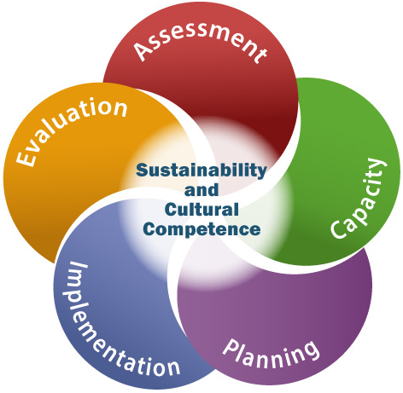
Strategic Prevention Framework (SPF)
SAMHSA’s SPF is a planning process for preventing substance use and misuse.
The five steps and two guiding principles of the SPF offer prevention professionals a comprehensive process for addressing the substance misuse and related behavioral health problems facing their communities. The effectiveness of the SPF begins with a clear understanding of community needs and involves community members in all stages of the planning process.
Notes:
Content Slide

Slide 25
BHSA Prevention Coaches, Training & Technical Assistance, and Professional Development
Notes:
Section Header Slide

Slide 26
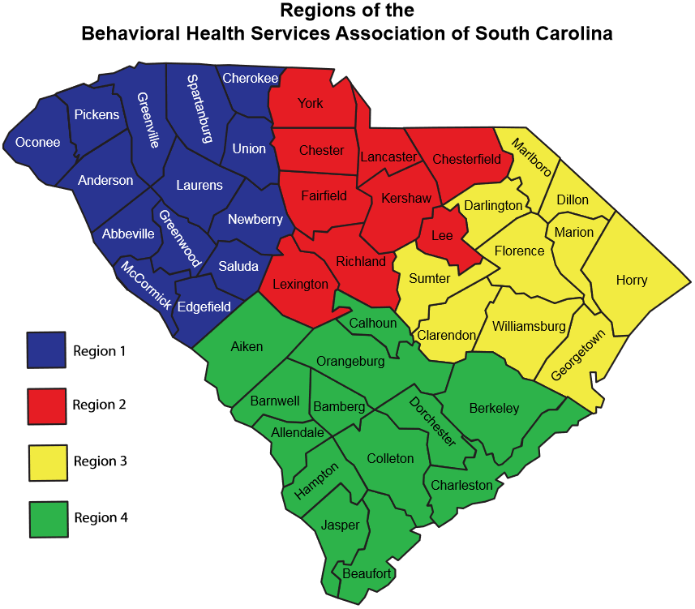
BHSA Prevention Coaches System
General Summary:
South Carolina’s county authorities are divided into four regions, and each region is assigned a BHSA Prevention Coach. The BHSA Prevention Coaches’ primary responsibility is to broaden the understanding and build the capacity of county authorities to utilize the Strategic Prevention Framework throughout the continuum by providing training and technical assistance to the four regions of the state.
Notes:
Content Slide

Slide 27
BHSA Prevention Coaches System
More specifically, BHSA Prevention Coaches will:
Provide Generalized Training & Technical Assistance (TTA)
This level of TTA involves wide-range distribution of resources for putting the SPF into practice. Additional generalized TTA raises awareness on issues and helps county authorities and communities develop strategies for system design and implementation. This type of broad-based TTA can be provided at a state, regional, or multi-county level through trainings, webinars, web-based learning platforms, etc.
Notes:
Content Slide

Slide 28
BHSA Prevention Coaches System
More specifically, BHSA Prevention Coaches will:
Provide Individualized TTA
This level of TTA is a customized approach that a Prevention Coach develops in response to a specific issue/need identified by a single county agency. The Prevention Coach will work with counties individually to identify specific TTA needs, as well as coordinate and/or implement the TTA service.
Notes:
Content Slide

Slide 29
BHSA Prevention Coaches System
Administrative Duties and Responsibilities
Serve on and assist the BHSA Prevention Committee with strategic planning and resource development
Participate on local and state committees or task forces as needed
Develop a statewide annual county coaching plan
Conduct an annual TTA needs assessment survey
Act as a liaison between DAODAS and statewide behavioral health agencies, organizations, and coalitions
Other duties as required
Notes:
Content Slide

Slide 30
BHSA Prevention Coaches System
Name | Assigned Regions | E-mail Address | Telephone Number
Ashley Bodiford | Region 2 Region 3 | abodiford@bhsasc.org | 803-422-5728 (c)
Lou Anne Johnson | Region 1 Region 4 | lajohnson@bhsasc.org | 864-360-4822 (c)
Notes:
Content Slide

Slide 31
Professional Development Opportunities
Prevention Quarterly Meetings
Occur 4 times a year
2 hosted by DAODAS
2 hosted by the S.C. Association of Prevention Professionals and Advocates (SCAPPA)
Regional Meetings & Trainings
Regional meetings & trainings occur on a regular basis, with topics chosen according to needs
Regional trainings occur at least twice per year, and at least 4 webinars are hosted or promoted
DAODAS Trainings
“Ethics in Prevention” offered at least once per year
“Substance Abuse Prevention Skills Training (SAPST)” offered at least once per year
SCAPPA Annual Meeting
SCAPPA Spring Training (occurs biennially)
Multiple National Conferences
Notes:
Content Slide

Slide 32
South Carolina Association of Prevention Professionals and Advocates
Vision
The South Carolina Association of Prevention Professionals and Advocates is a proactive organization providing leadership in all areas of prevention.
Mission
The mission of the South Carolina Association of Prevention Professionals and Advocates is to promote high standards of quality in prevention by providing workforce development, membership support, certification, public recognition & advocacy for professionals and advocates in order to advance the profession of ATOD-related prevention.
Copy and paste this link into your address bar to visit the SCAPPA website:
http://www.scappaonline.org/
Notes:
Content Slide

Slide 33
South Carolina Association of Prevention Professionals and Advocates
The South Carolina Association of Prevention Professionals and Advocates (SCAPPA) is dedicated to providing its members with the tools and resources necessary to make a difference within South Carolina.
Membership with SCAPPA will provide you with all of the information you need to become a Certified Prevention Specialist or Certified Senior Prevention Specialist. It will also allow you to become credentialed at a discounted rate. SCAPPA members have special access to the association’s website, which provides them with shared resources from around the state such as presentations, newsletters, training opportunities, and more.
Notes:
Content Slide

Slide 34
Prevention Code of Ethics
The Principles of Ethics are a model of standards of exemplary professional conduct. The Principles of the Code of Ethical Conduct for Prevention Professionals express the professional’s recognition of his or her responsibilities to the public, to service recipients, and to colleagues. They guide members in the performance of their professional responsibilities and express the basic tenets of ethical and professional conduct. The principles call for commitment to honorable behavior, even at the sacrifice of personal advantage. (Hogan, Gabrielsen, Luna & Brothaus, 2003)
They are guided by core values and competencies that have emerged with the development of the prevention field.
Follow this link for a complete list and description of the Prevention Code of Ethics:
https://internationalcredentialing.org/creds/ps
Notes:
Content Slide

Slide 35
Resources and References

Slide 36
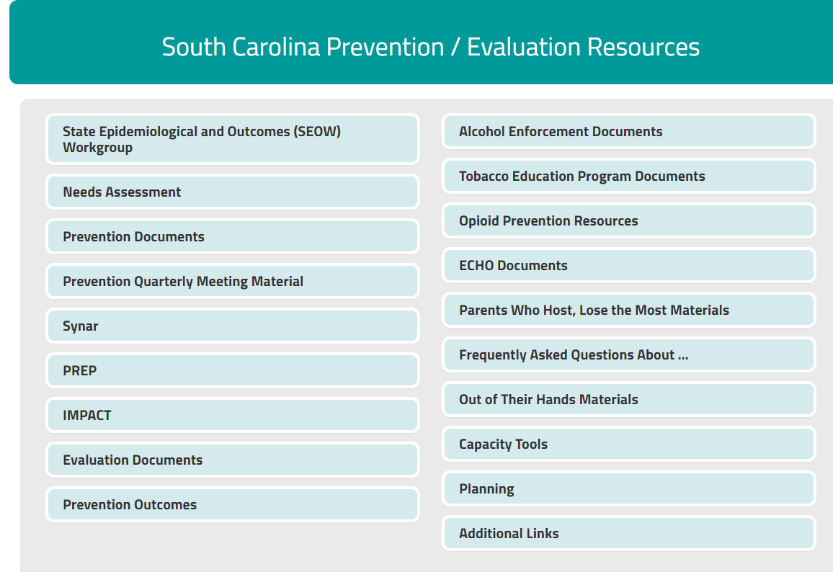
SC Documents Website
DAODAS has created a website to make it convenient for prevention professionals in South Carolina to access resources (important information, data, documents/forms, etc.) related to prevention.
You can access the website by following this link:
http://ncweb.pire.org/scdocuments/
Notes:
Content Slide

Slide 37
Resources
Community Toolbox – Free Tools and Resources https://ctb.ku.edu/en
National Institute on Drug Abuse (NIDA) https://www.drugabuse.gov/related-topics/prevention
Centers for Disease Control and Prevention (CDC) https://www.cdc.gov
Communities That Care https://www.communitiesthatcare.net
W.K. Kellogg Foundation https://www.wkkf.org/who-we-are/overview?#mission-vision
Substance Abuse Prevention, The Intersection of Science and Practice Textbook by Hogan, Gabrielsen, Luna & Grothaus, 2003
Coalitions and Partnerships in Community Health Textbook by Frances Dunn Butterfoss, 2007
Prevention Technology Transfer Center https://pttcnetwork.org/centers/southeast-pttc/home
Notes:
Content Slide

Slide 38
Resources for South Carolina Prevention Professionals
Mosaix IMPACT https://scimpact.onmosaix.com/
International Certification & Reciprocity Consortium (IC&RC) https://www.internationalcredentialing.org/
Just Plain Killers http://justplainkillers.com/
Prevention Institute https://www.preventioninstitute.org/about-us
DAODAS http://www.daodas.sc.gov/
SC Documents http://ncweb.pire.org/scdocuments
SCAPPA http://www.scappaonline.org/
SAMHSA https://www.samhsa.gov/
Notes:
Content Slide

Slide 39
Questions?
Notes:
Q&A Slide

Slide 40
1801 Main Street, 4th Floor • Columbia, South Carolina 29201
telephone: 803-896-5555 • fax: 803-896-5557
www.daodas.sc.gov
Notes:
Final Slide

