Slide 1

Infectious Disease and Substance Use Disorder:
A Synergy of Epidemics
Linda Brown, MPH
Overdose Prevention Coordinator
Infectious Disease Consultant
Notes:
Custom DAODAS color codes is : Red-0
Green-131
Blue-139

Slide 2
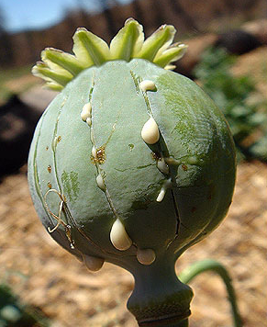

Notes:
Content Slide

Slide 3
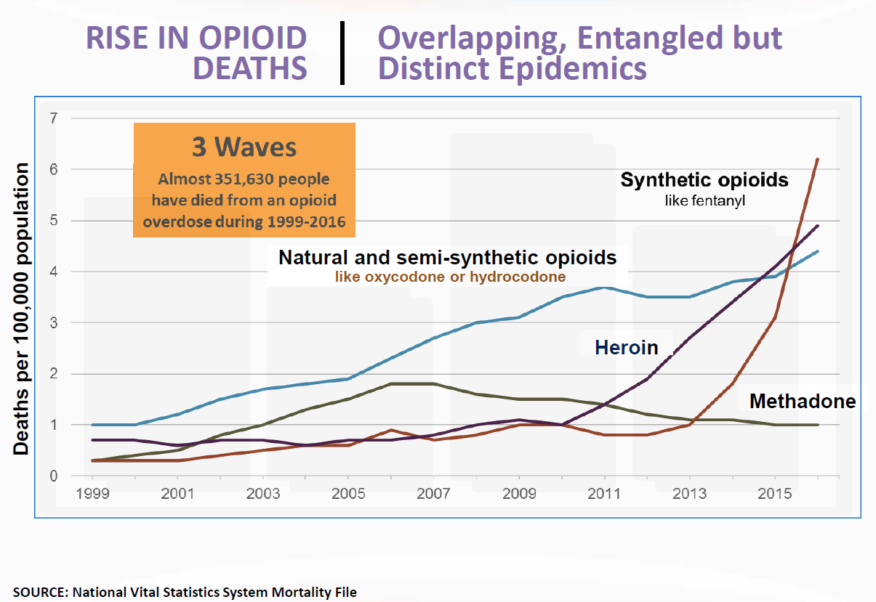
Notes:
Content Slide With No Bottom Border

Slide 4
Acronyms And Abbreviations
PWID: People Who Inject Drugs
PWUD: People Who Use Drugs
SUD: Substance Use Disorder
OUD: Opiate Use Disorder
OAT: Opiate Agonist Therapy
SEP: Syringe Exchange Program
SSP: Syringe Services Program
SSTI: Skin and Soft Tissue Infections
PrEP: pre exposure prophylaxis
WWUD: Women Who Use Drugs

Slide 5
2.1 Million Americans have substance use disorders.
The CDC reported 67,744 drug overdose deaths in the U.S. in 2018 with 47,016 (69.4%) involving an opioid. 1
Deaths involving synthetic opioids (other than methadone) have increased across all demographic categories.
  Illicitly manufactured fentanyl (IMF), is fueling the opioid epidemic. IMF is increasingly mixed into heroin, cocaine, and counterfeit pills with or w/o user’s knowledge.
Overdose deaths is the leading cause of injury death in the United States, surpassing those deaths due to gun violence or automobile injuries.

Slide 6
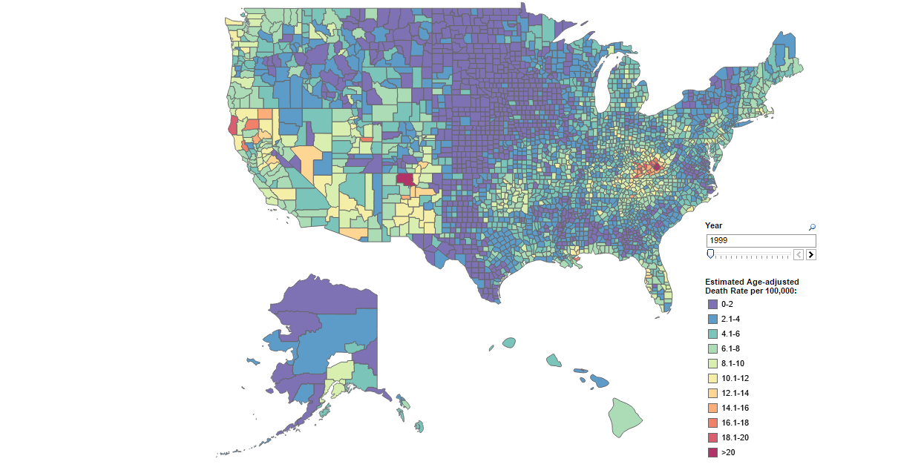
2000 Drug Overdose Death Rates by County

Slide 7
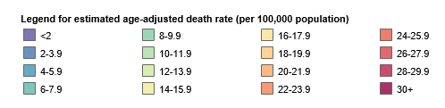
2016 Rapid Increase in Drug Overdose Death Rates by County

Slide 8
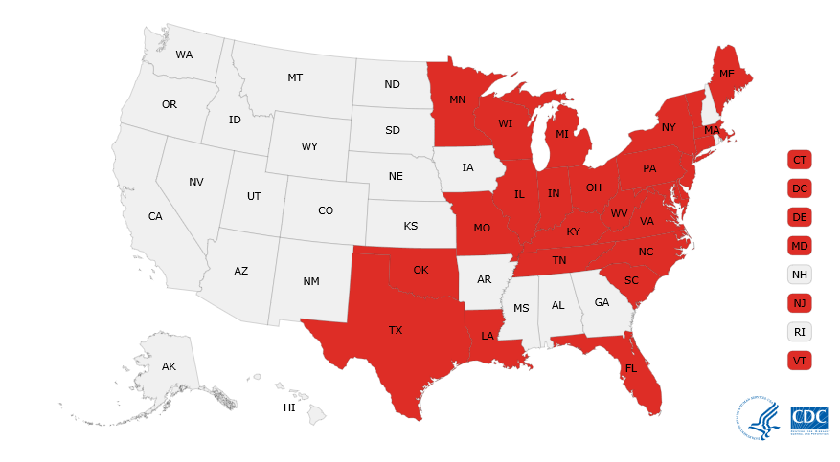
Statistically significant drug overdose death rate increase from 2015 to 2016, US states

Slide 9
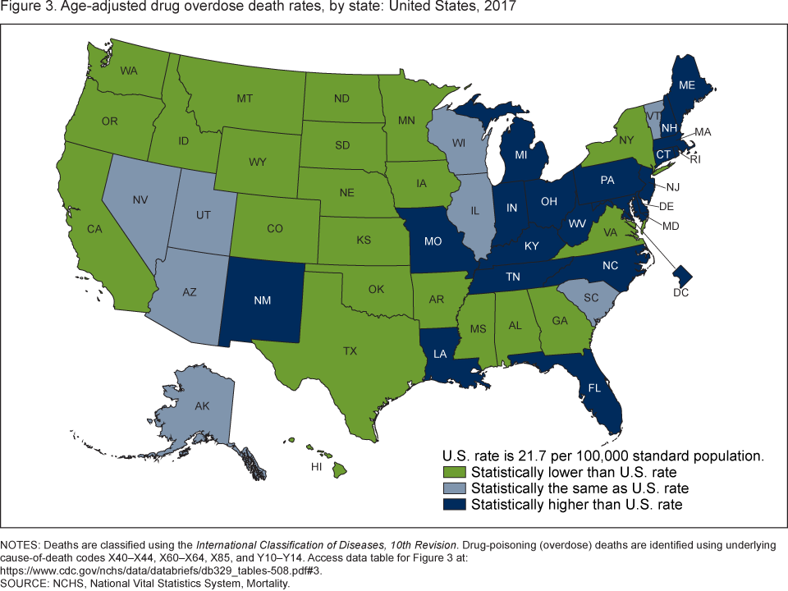

Slide 10
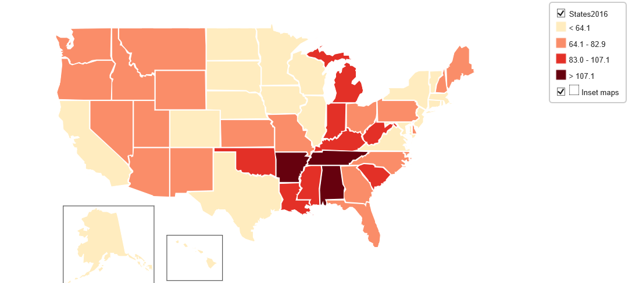

Slide 11
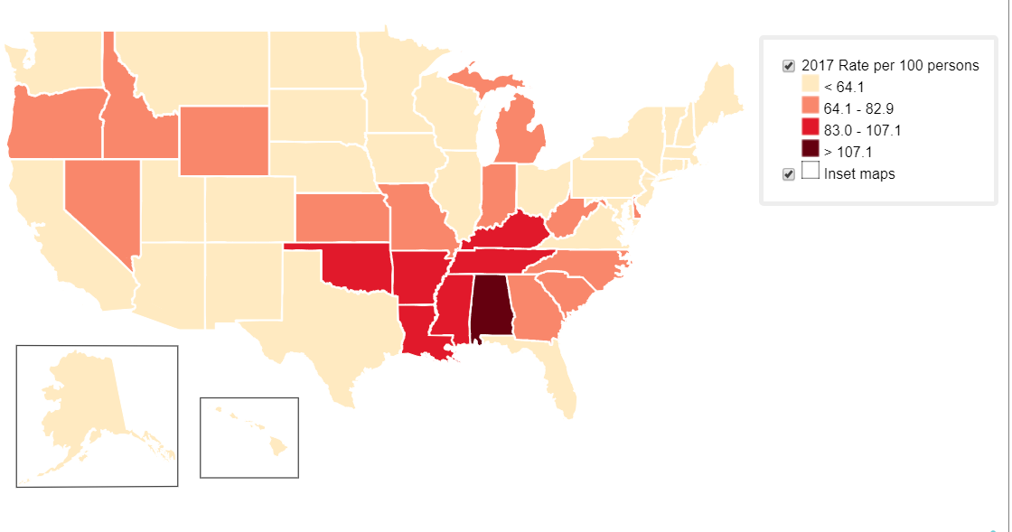
Source: CDC U.S. State Prescribing Rates, 2017

Slide 12
The Impact of Opioids in South Carolina
Opioid involved overdose deaths have been steadily increasing in South Carolina.
In 2018, Opioid related deaths totaled 816 which was a 9.1% increase from 2017 (748). (SC DHEC, Office of Vital Statistics)
  (445 homicides and 730 automobile fatalities occurred in 2017)
2018 hospital data shows that 10,756 patients were discharged from emergency departments (EDs) and inpatient departments with issues related to opiate use/dependence throughout our state. (Office of Revenue & Fiscal Affairs)
2018 hospital data reports that 6,802 patients were discharged from emergency departments (EDs) and inpatient departments due to opioid overdose. (Office of Revenue & Fiscal Affairs)
There has been a 121% increase in service utilization at state-funded substance use disorder treatment programs for individuals looking for help with an opioid use disorder from CY 2008 (3,014) to CY 2018 (6,649). (DAODAS)

Slide 13
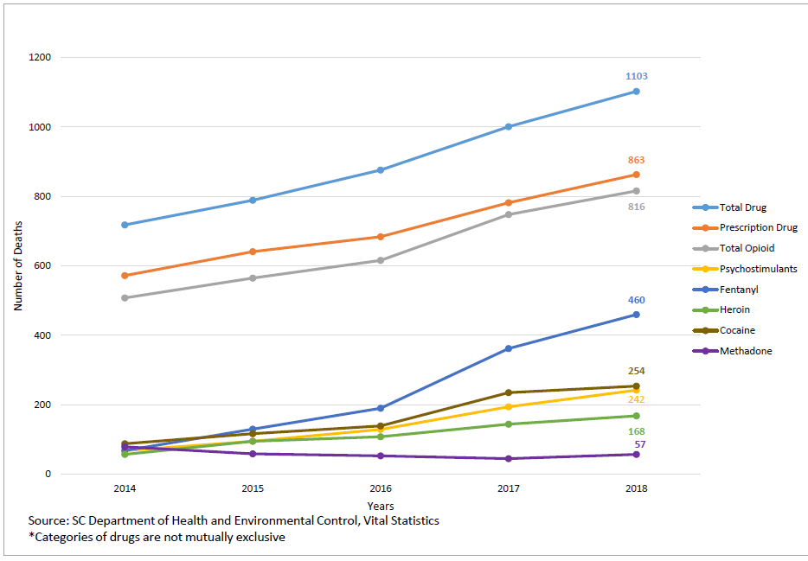

Slide 14
Number of Opioid-Involved Overdose Deaths by County South Carolina, 2018 Occurrence Data
Source: SC DHEC, Vital Statistics

Slide 15
Change in Opioid-Involved Overdose Deaths by County, South Carolina, 2017-2018, Occurrence Data
Statistically significant at 95% confidence interval
Percent change not calculated for counties with fewer than 10 deaths in 2018.
Source: SC DHEC, Vital Statistics

Slide 16
Syndemic Conditions
A syndemic or synergistic epidemic is the aggregation of two or more concurrent or sequential epidemics or disease clusters in a population with biological interactions, which exacerbate the prognosis and burden of disease.
The term was developed by Merrill Singer in the mid-1990s.

Slide 17
The Inexorable Spread of Infectious Diseases
Viral Hepatitis A (HAV):
Initial outbreak declared in Aiken in Feb. 2019.
DHEC declared a statewide HAV outbreak in May, 2019. 75% of identified HAV cases have been hospitalized. One death has occurred in relation to an HAV infection.
Most cases are among men ages 30-34 years old.
Risk groups include:
PWID or PWUD
Homeless individuals
Men who have sex with men (MSM)
Individuals who are or recently were incarcerated.

Slide 18
The Inexorable Spread of Infectious Diseases Continued
Viral Hepatitis C (HCV)
HCV is the most common chronic bloodborne pathogen in the U.S. and is a leading cause of complications from liver disease.
HCV is associated with more deaths than the top 60 other reportable infectious diseases combined, including HIV. (Clin infect Dis., 2016)
CDC reports that the rate of acute hepatitis C virus (HCV) infections increased by 350% between 2010 and 2016, driven by IDU.
Sharp increases in transmission rates among:
  Young persons: age groups 20-29 and 30-39 (CDC Surveillance report, 2016)
  Pregnant women: HCV cases doubled among pregnant women ages 15-44 (2206-2014) . The rise of perinatal transmission risk prompted KY to require HCV testing during pregnancy.
The most important risk factor for HCV infection is past or current injection drug use.

Slide 19
The Inexorable Spread of Infectious Diseases Continued
HIV: Resulting from IDU decreased 63% from 2000-2010 until 2011 when trend began to level off. Between 2014 and 2015, HIV acquired by unsafe injecting practices increased by 4%. (CDC Surveillance report, 2016)
HIV/HCV Co-Morbidity: Nearly 75% of people with HIV who inject drugs also are infected with HCV.
  HIV/HCV coinfection more than triples the risk for liver disease, liver failure and liver-related death (CDC HIV and Viral Hepatitis Fast Facts, June 2017)

Slide 20
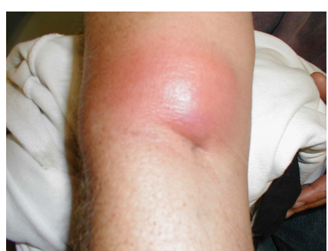
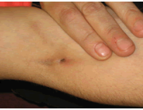
Soft Skin Tissue Infections
SSTIs and endocarditis: Hospitals across the U.S. have seen a rise in admissions due to these infections, especially among young people, which is related mainly to unsafe injection practices. (Ronan, 2016)

Slide 21
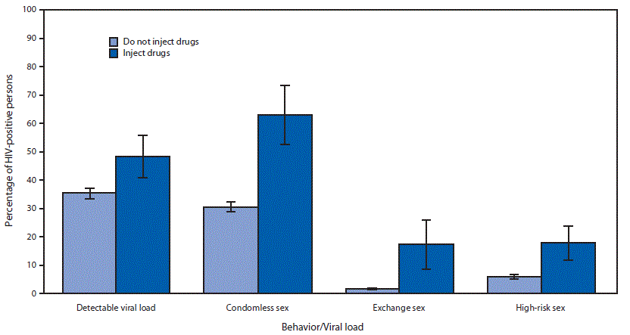
Percentage of persons with diagnosed human immunodeficiency virus (HIV) (n = 233) who engaged in high risk sexual behaviors or had a detectable viral load — Medical Monitoring Project, United States, 2015–2017
Dasgupta S, Tie Y, Lemons A, Wu K, Burnett J, Shouse RL. Injection Practices and Sexual Behaviors Among Persons with Diagnosed HIV Infection Who Inject Drugs — United States, 2015–2017. MMWR Morb Mortal Wkly Rep 2019;68:653–657. DOI: http://dx.doi.org/10.15585/mmwr.mm6830a1external icon

Slide 22
Recent MMWR reported results from a study of injection practices and sexual behaviors among person with diagnosed HIV infection who inject drugs in the U.S. between 2015-2017
A higher percentage of HIV PWIDs had detectable viral loads than HIV+ persons that did not inject drugs.
Condomless sex, exchange sex, and high-risk sex were all more prevalent among HIV+ PWID than HIV+ persons that did not inject drugs.
80% of HIV+ PWID in sample did not obtain AOD services (ex. harm reduction education, talk therapy or Medication assisted therapy (MAT)).
The absence of important syringe services programs in an area reduces access to much needed co-located services (i.e. provision of PrEP, condoms, sterile injection equipment, and HIV medical care.
30% of participants reported reusing syringes instead of disposing after one use. This increases the risk for serious bacterial infections such as endocarditis and skin abscesses.

Slide 23
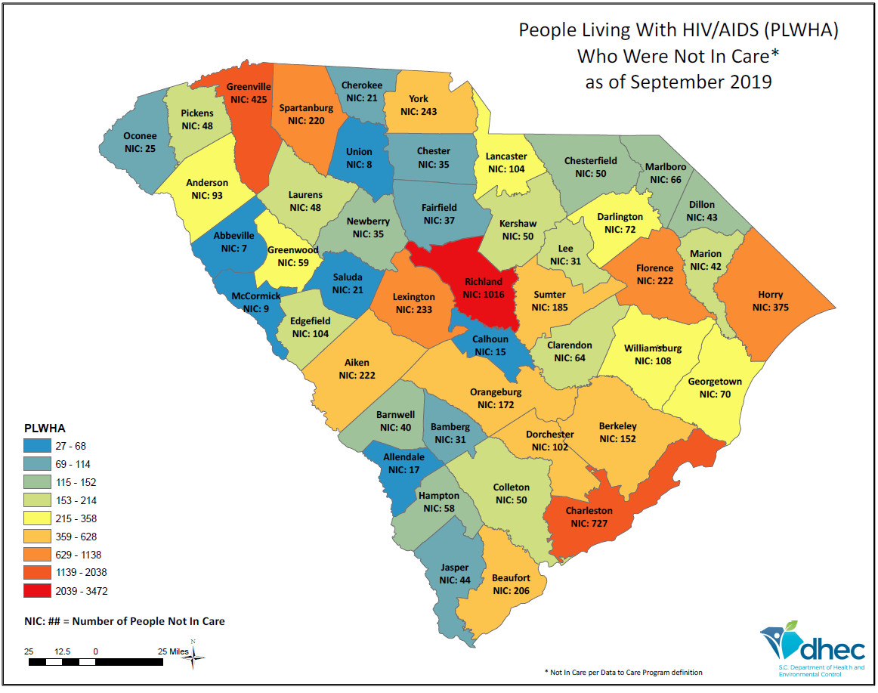

Slide 24
Percentage of PLWHA engaged in each step of the HIV continuum of care, by reported risk (2017)
Source: SC Epi Profile, 2018
Notes:
If we also look at the continuum of care among reported risk behaviors we see that:
Persons who injected drugs fared worse in all categories meaning they are:
Less likely to receive care
Less likely to be retained in care and
Less likely to reach viral suppression

Slide 25
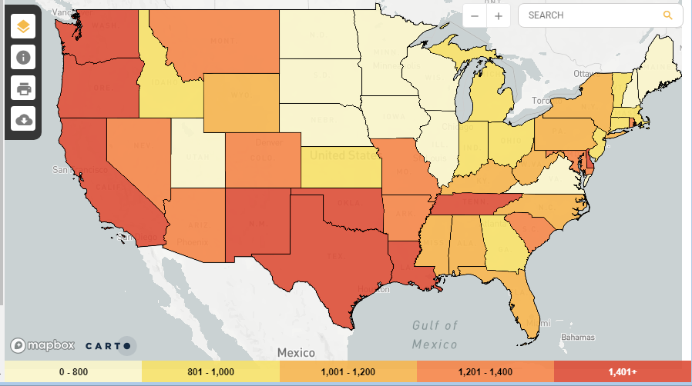

Slide 26
Reported Cases of Viral Hepatitis in SC 2013-2018 | 2014 | 2015 | 2016 | 2017 | 2018
Hepatitis A, Acute | 7 | 16 | 22 | 21 | 30
Hepatitis B, Acute | 35 | 31 | 34 | 41 | 47
Hepatitis B, Chronic | 516 | 463 | 464 | 479 | 517
Hepatitis B, perinatal | 1 | 0 | 0 | 0 | 0
Hepatitis C, Acute | 4 | 5 | 12 | 14 | 25
Hepatitis C, Chronic | 3,770 | 4,550 | 6,195 | 6,730 | 6,472
Source: DHEC, Division of Acute Disease Epi, 2018

Slide 27
HCV Among Persons Who Inject Drugs (PWIDs)
IDU is the principle “motor” of HCV incidence
The virus is extremely concentrated in the blood of infected patients
  The average patient has a blood concentration of hepatitis C virus of 2 million particles per milliliter of whole blood!
  Small viral particles + quick replication = high number of viral particles in the blood.
These infections are acquired relatively rapidly among IDUs:
  HBV: 50%-70% acquire within 5 years of beginning injection drug use
  HCV: 50% to 80% acquire within 5 years of beginning IDU
  HIV: 1%-10% within 5 yrs of beginning IDU
Source: Arch Intern Med. 2011;171(3):242-248
Notes:
HIV produces 1 to 10 billion viruses each day
HCV produces 1 to 10 trillion viruses each day
Milliliter size: amount of blood that would sit on the head of a very small needle.

Slide 28
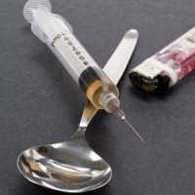
IDU Risk
Viral Infectivity of HCV persists for:
Up to 63 days in syringe barrel & dead space
Up to 21 days in H20 in plastic container
Up to 14 days on inanimate faces (cookers & inj. surfaces)
Up to 24 hours in filter; and 48 hours when foil-wrapped
So even if users do not share syringes, they can still be at risk!

Slide 29


HIV/HCV Outbreak in Scott County, Indiana
Investigators identified nearly 500 at risk individuals during contact tracing
  Among newly diagnosed, 96% reported IDU (mostly using Opana)
  Daily # of injections ranged from 4 -15 (one needle reportedly used 300+ times)
  # injection partners ranged from 1-6 per injection event
94.2% co-infected with HCV
Scott county now has SSPs as a response to CDC outbreak investigation and strong recommendations

Slide 30
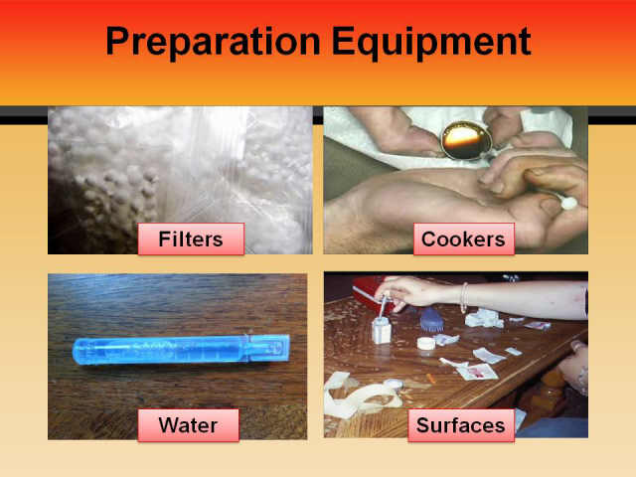
Preparation Equipment

Slide 31
POA Injection Risk
More water is required to dissolve prescription pills than is for powder or even black tar. (due to binding agents and diversion ingredients which make the mixture gooey.)
Longer prep time for pills vs heroin etc. (this extends opportunity for infection from contaminated equipment)
HCV-contaminated solution needs to be heated for almost 90 seconds & reach a temperature of 144 F for infectivity to be at undetectable levels
Strategies PWIDs use to overcome these injection barriers that can increase transmission risks:
  Dividing up pills/multiple injections (to produce a more manageable solution)
  Use of larger, detachable barrel syringes with more dead space in the barrels. High dead space syringes, (HDSS) retain over 1000 times more blood after rinsing than do low dead space syringes, (LDSS). (Source: Zule, et. al. 2009)
Notes:
Dividing up pills/multiple injections: So people can either do three distinct injections or
They can use a bigger barrel syringe.
Both options are risky for increasing HCV transmission risk.

Slide 32
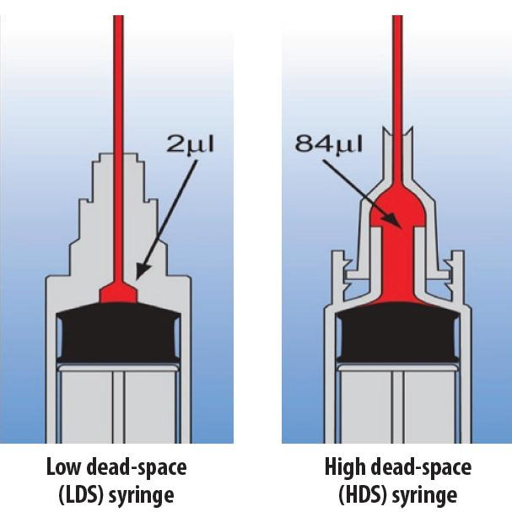

Slide 33
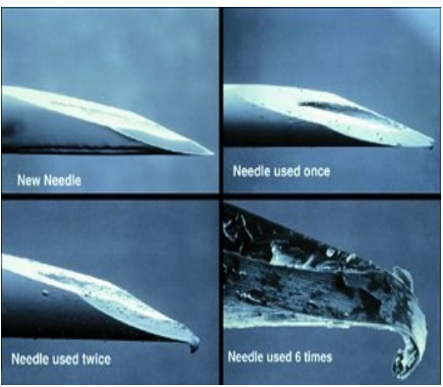
Risks:
Dull needles
  Increases blood due to multiple sticks required.
Blood underneath the finger nails can spread virus on cotton, in water (when holding cooker)
Even small amounts of blood can spread viruses
Notes:
Dull needles cause more blood and increases the chance for blood borne pathogens/viruses (i.e. HCV) to be transmitted. Blood underneath the fingernails for instance are a huge problem- even when a PWID reach for a cotton ball from a bag. Microscopic amounts of blood get transferred.

Slide 34
Addressing Synergistic Epidemics With
Integrated Approaches

Slide 35
Infectious Disease Prevention
Research has shown that providing MAT is tantamount to HIV and HCV prevention
OAT: research has shown that Opiate Antagonist Treatment (OAT) reduces an individual’s risk of acquiring:
    HIV by ~54% and (Aspinall, et., al. 2014)
    HCV by ~50% (Platt, et., al. 2017)
SSPs: Associated with a 34% reduction in HIV and as much as a 76% reduction in HCV.
    Since 2016, the consolidated appropriations act gives states, under limited circumstances, opportunity to support certain components of a SSP with fed funding. States are required to consult with CDC and provide a “determination of need” application.
        DHEC received a letter from CDC stating they found a “determination of need” in South Carolina (based on HCV rates) to indicate that we could benefit from SSP to decrease the spread of infectious diseases such as HCV and HAV.
Notes:
Determination of need app: 1) experiencing , or (2) at risk for significant increases in hepatitis infections or an HIV outbreak due to injection drug use

Slide 36
Integrated Treatment
  HIV Treatment and OAT
    69% increase in recruitment onto (ART),
    two-fold increase in ART adherence,
    23 % decrease in odds of ART attrition and
    45 % increase in odds of viral suppression (Low et al., 2016)
  HCV Treatment and OAT:
    Cure rates for PWID treated for HCV can reach 94% among individuals on OAT as well as those who are not (Dore et al., 2016; Grebely, 2017; Grebely et al., 2016; Zeuzem et al., 2015)
Notes:
Collaboration between health departments and state drug authorities should be ongoing to leverage funding for HIV and HCV testing and linkage to care

Slide 37
Integrated Approaches Continued
Hospitals:
  Increase early treatment of SSTIs and endocarditis with goal of decreasing ED visits
  Utilize peer support staff for linkage to SUD treatment programs
SUD Treatment sites:
  Fast track patients post hospital release into treatment (i.e. MAT/OAT and talk therapy)
Infectious Disease Clinics:
  Continuously assess HIV patients for SUDs at each visit
Correctional Health:
  HIV: transition out of prison is a critical time for HIV HAART interruption and a risky time for transmitting HIV or HCV (via needle/equipment sharing)
  OAT: (i.e. Vivitrol)
Notes:
Correctional health: Retrospective cohort study followed 2,000 HIV infected inmates discharged from TX prison system with 10 day supply of HAART. They were required to refill prescription within 5 days of release. Only 5 % did so within 10 days and only 30% had done so within 60 days. 95% of recently released people on HIV tx interrupted their therapy and were more likely to transmit an infection at a time when they were more likely to engage in risky sexual and/or drug use.

Slide 38
Challenges to Integration
SUD treatment system is “underprepared” to support HIV//care coordination
Lingering misperceptions regarding the use of MAT as a best practice
The primary care system has been slow to implement MAT, and other vital coordination services such as prevention and early intervention services
Many healthcare sites often experience staffing shortages and/or their staff do not possess the skillsets necessary to address substance use disorders
Patient confidentiality can often serve as barriers to the exchange of information necessary to provide comprehensive services
We need a type of “Ryan White” for OUD to prioritize and sustain integrated approaches
Research conducted through the Office of AIDS focuses on viral suppression above all, missing opportunities to explore HIV from the lens of the virus as casualty of OUD.
Notes:
Last bullet: What good does it do for an HIV+ person to reach viral suppression if they die from an overdose?

Slide 39
Notes:
So clearly integration is best practice however because fentanyl presents such present danger into the epidemic, it is paramount to ensure that a person has access to OUD treatment and is stable in their recovery quickly! They may OD and die before they can reach viral suppression.

Slide 40
Addressing the Epidemics in
South Carolina

Slide 41
Hepatitis A Vaccines:
  Collaborating with DHEC to provide free hep A vaccine to patients in county drug authority sites
Vulnerability Study:
  Study to determine which counties in SC might be vulnerable to an HCV/HIV outbreak such as the one in Indiana
Reinstatement of HIV EIS services:
  SC AIDS case rate once again meets the threshold to enable DAODAS to strategically allocate HIV EIS block grant dollars for the provision of HIV testing and linkage to care services within county drug authority sites.

Slide 42
Ending the Epidemics SC
(EtE SC)
Our Vision:
A South Carolina free of new cases of HIV, STDs,
Viral Hepatitis and Substance Use Disorders
∞
Stay safe ○ Get Tested ○ Treat early ○ End stigma

Slide 43
Established statewide EtE SC Workgroup
Established a diverse steering committee to
create:
  A vision statement
  Goals and objectives
Established Fast-Track Cities (ongoing)
  Columbia (February, 2019)
  Charleston (June, 2019)
  TBD (Greenville, Spartanburg, Orangeburg, etc.)
Received $375K one-year planning grant which allow us to develop a coordination plan
  By end of February, 2020, DHEC will hire:
    four regional Planning Coordinators that will be specific to each region (Upstate, Lowcountry, Pee Dee, Midlands)
    One data manager that will generate materials for enhanced data visualization using our SC Epi Profile developed specifically for each four regions of the state.
    Coordinate multiple town hall meetings within each region of the state to ensure local and diverse voices and ideas are included in our planning.

Slide 44
Key Stakeholders
Local health department leaders
  Regional public health clinicians and social workers
  epidemiologists
Ryan White recipient and grantees
  Peer/consumer advocates
  HOPWA recipient and grantees
  Infectious disease clinics
  HIV prevention council
CDC prevention funded recipients and grantees
  HIV prevention partners
SAMHSA recipients and grantees
  Mental health and substance use programs across the
  continuum (to include persons in recovery)
  Peer advocates
Other Government agencies (including non HIV community focused)
  Department of corrections
  Department of Education
  Department of Health and Human Services
  Department of Social Services
  Department of Mental Health Services
Veterans Affairs
Private health systems
  Pharmaceutical companies
  Insurance companies
Academic institutions (Universities and colleges)
Faith community
Local public health and substance use prevention coalitions
Other county agencies (i.e. jails)

Slide 45
Questions?
Notes:
Q&A Slide

Slide 46

1801 Main Street, 4th Floor • Columbia, South Carolina 29201
telephone: 803-896-5555 • fax: 803-896-5558
www.daodas.sc.gov
Notes:
Final Slide

